Slide 1
Extracting users‘ locations
Khalil Hajji

Slide 2
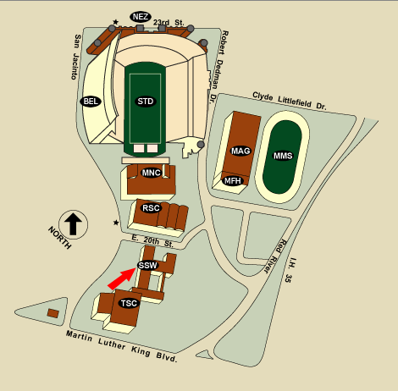


Goal
Regroup Gps points in meanful clusters
Cluster 5
Cluster 1
Cluster 3
Cluster 4
Cluster 2
Increase the amount of information we have about locations:
Infer the location of the user even if it is not known initially

Slide 3


Solution: combining features
Use the WiFi feature in parallel with the Gps one
Cluster 5
Cluster 1
Cluster 3
Cluster 4
Cluster 2

Slide 4

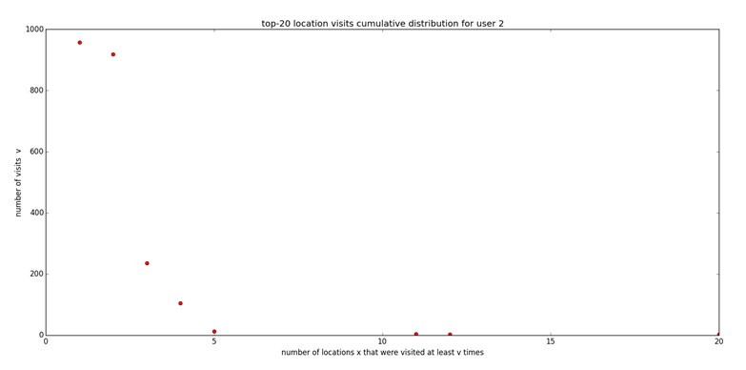
Results evaluations (1):
All the users visits 2 clusters much more frequently than all the others:
Good because humans tend to travel between their home & their work

Slide 5
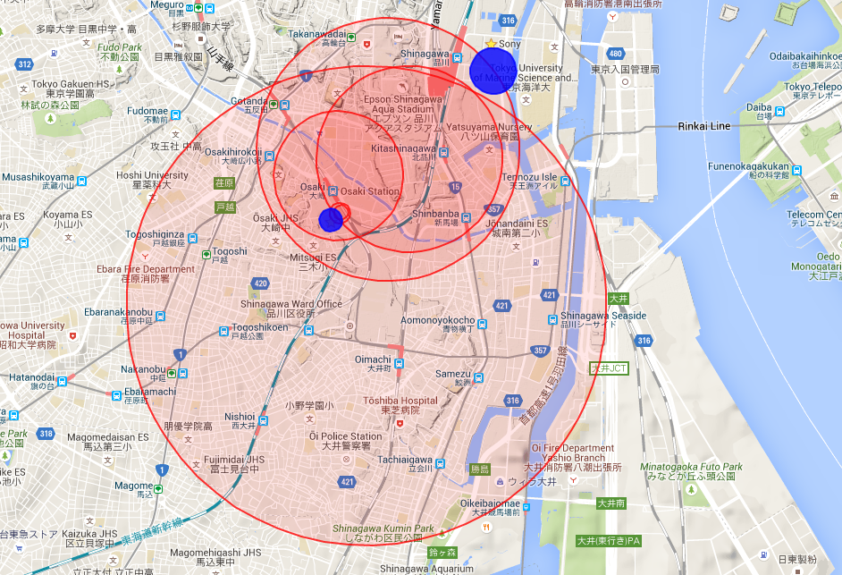
Results evaluations (2):
For all users working in Sony, one of the 2-most visited cluster is in the Sony area

Slide 6
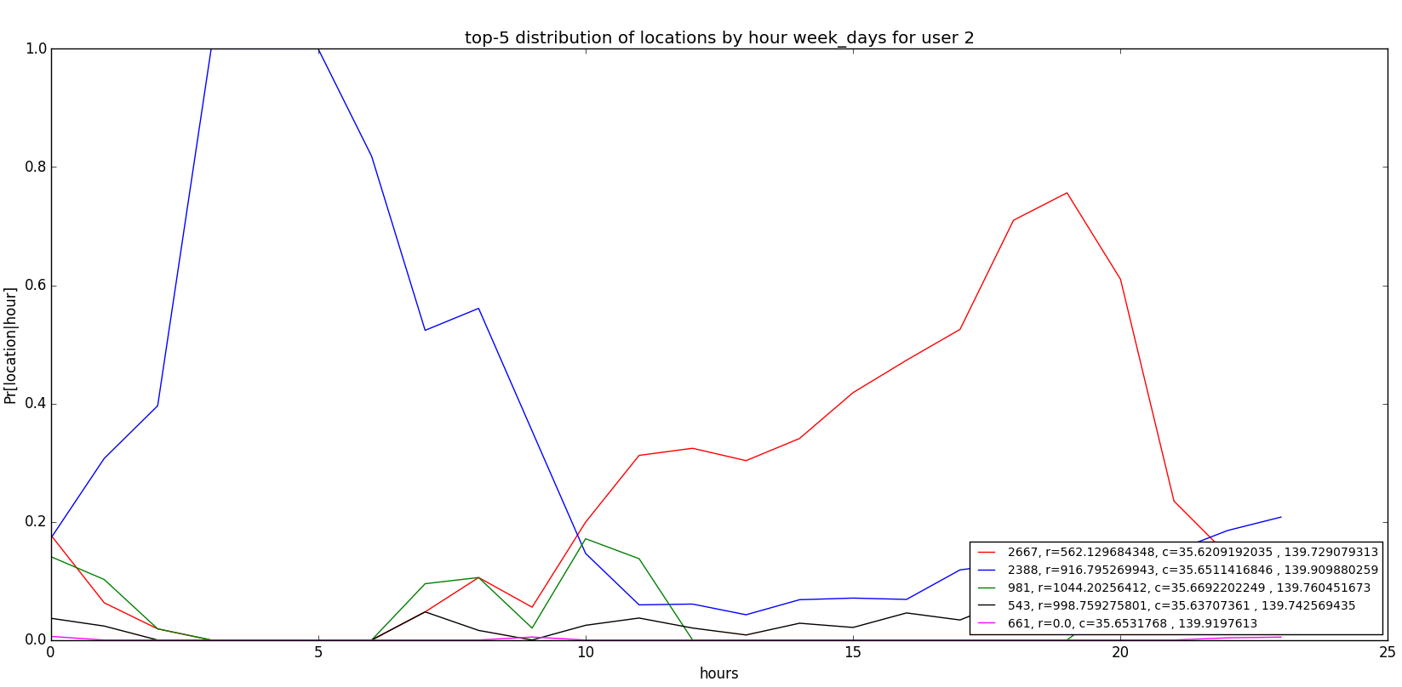
Results evaluations (3):
This work location is visited by the users during the working hours
During the night, the users is mostly always in the same location -> certainly their home

Slide 7
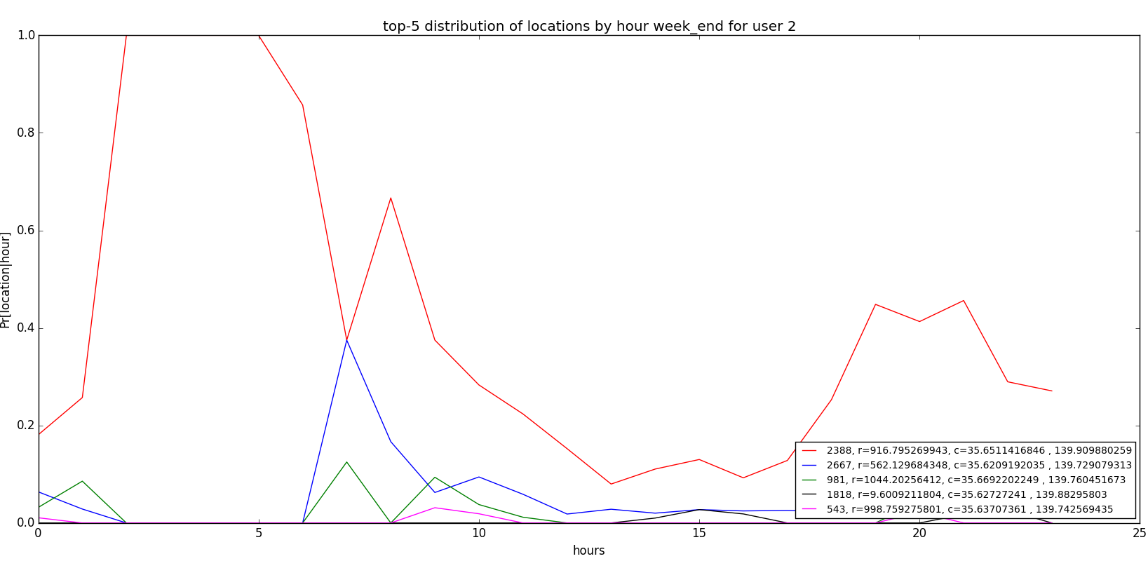
Results evaluations (4):
The same location is visited during the day in the week-ends
Good because it confirms the hypotethis of the home

Slide 8

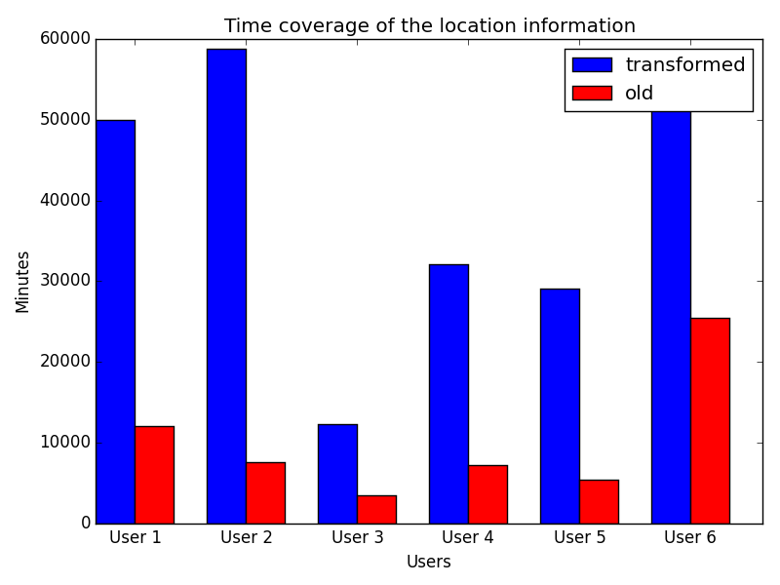
Results evaluations (5):
We have in average 5 times more information about the location by using this approach !!

